Slide 1
Cyber_solutions Internet Café
Data Authentication and Authorization Project
Developed by Group 6
For
Information Encoding standards (bdat 1001)
Final project

Slide 2
TABLE OF Contents
Title
Project Summary
The Team
Setup tool
Setup-Classes
Classes
Database
Execution
Live Demo

Slide 3
PROJECT SUMMARY
Cyber_Solutions Internet Café is an internet café in downtown Barrie, Ontario Canada. They have 10 active computer stations which the café user use to access internet after paying for they required minimum hours of use.
Problem statement: The Cafe Admin and staff need to daily develop a unique login ID and code for each user to be able to log in to each of the computers . This lead to ome issues like authorized access of these code y the café custerfmers.

Slide 4
PROJECT SUMMARY CONT'D
Mitigation: The Cafe contracted our team to develop a web application that generates a unique login Id and code daily for their different computers (normally called Stations). The Application is expected to have these features:
These code should expire on a daily basis.
Only registered members of the café can have access to these code.
There should be different registration channel for the Admin, Staff and User.
Admin: This is the Executive of the company. The CEO, COO and Manager
Staff includes the Cafe workers such as the customer attendant, supervisors, etc.
Users is the café's client that pays to use the café internet

Slide 5
THE TEAM
The team is made up of three data analysts from the Georgian College Big Data Analytics program:
Eugene A. Ofosuhene. A Petroleum engineer from Ghana with experience in Operations Project Management. He is keenly interested in Business Intelligence and looks forward to working in the Finance and Engineering Industry.
Emmanuel Bannerman: Has a background in Economics and Project Management, Wants to be a Sustainability Data Analysts.
Obianefo Obianuju Augusta: A graduate of Microbiology from Nigeria; with experience in Health Management. Being Analytically inclined, she hope to become a certified Data Analyst for Health management issues.

Slide 6
Set-up - Tools
Microsoft Visual Studio
Postman
JWT Authenticator
Microsoft SQL Server Management Studio

Slide 7
Set-up – Classes
ApplicationDbContexts.cs
AuthenticateController.cs
CafeLoginController.cs
LoginModels.cs
RegisterModels.cs
Response.cs
UserRoles.cs
CafeLogin.cs
Program.cs
appsettings.json

Slide 8
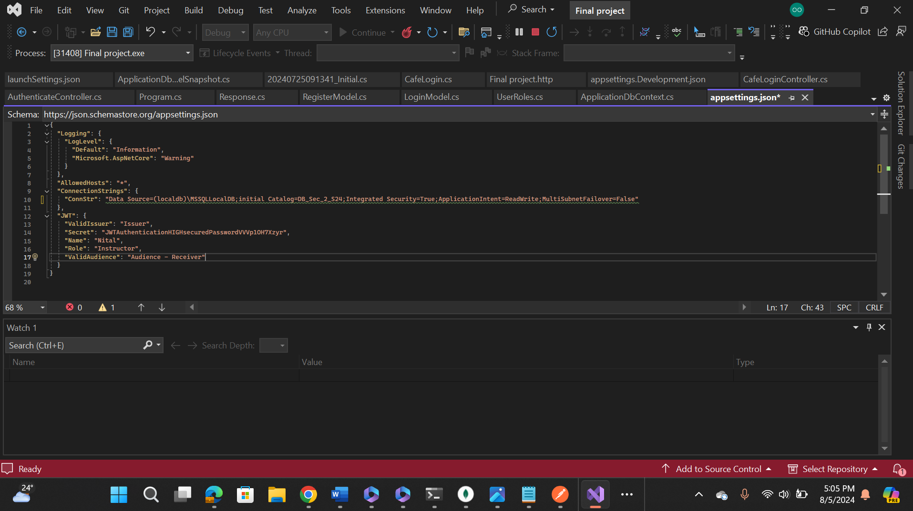
Classes – appsettings.json
Contains Database For storing generated (registered) Information
Contains JWT and secret Key passed to verify and give access to users

Slide 9
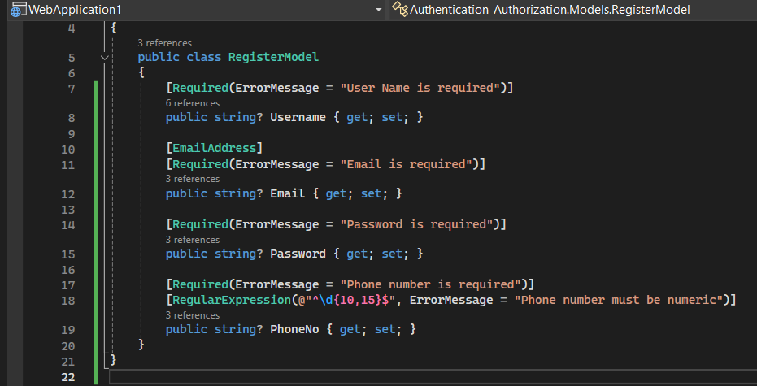
Classes – Register Models
Allows users to register. ‘Required’ indicates required fields. New Records are created with every registration (POST Method)

Slide 10
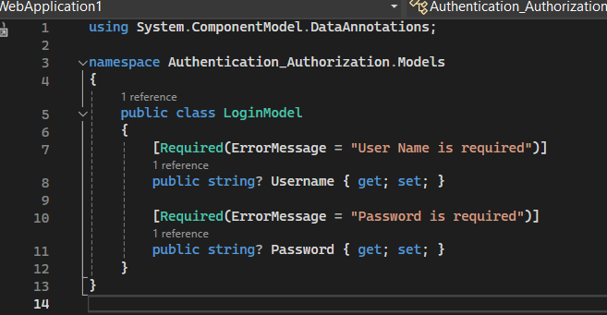
Classes – Register Models
After successful registration the User logs in through the Login Models.
Logins require pre-registered Usernames and Passwords.

Slide 11
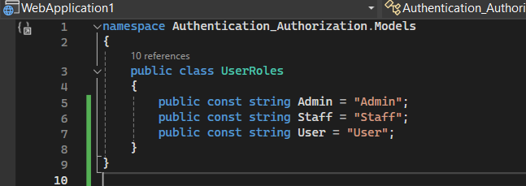
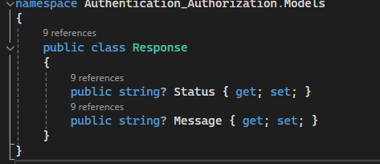
Classes – UserRoles and Response
UserRoles prescribes what access users will have (Admin, staff etc.)
Response gives the status of the connection to the server. (401 or 200 etc.)
Message = Success , Status = 200
Message = Authenticate , Status = 401

Slide 12
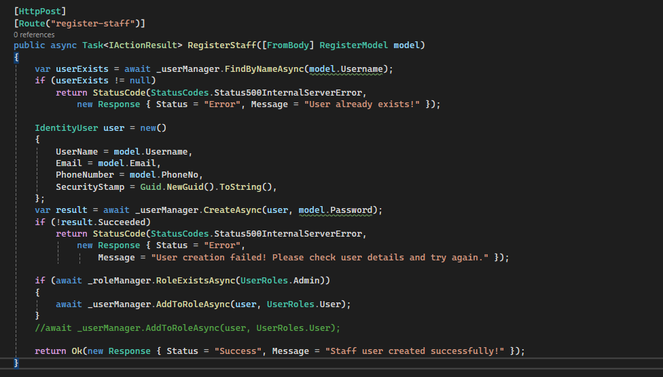
Classes – AUTHENTIFICATE CONTROLLER
Aside the default code, we created the Staff section of the user login which will enable the staff of Cyber_Solution to register

Slide 13
Database
The new database is created using the migration-builder.
Tables are also created in the database to store data after registration.

Slide 14
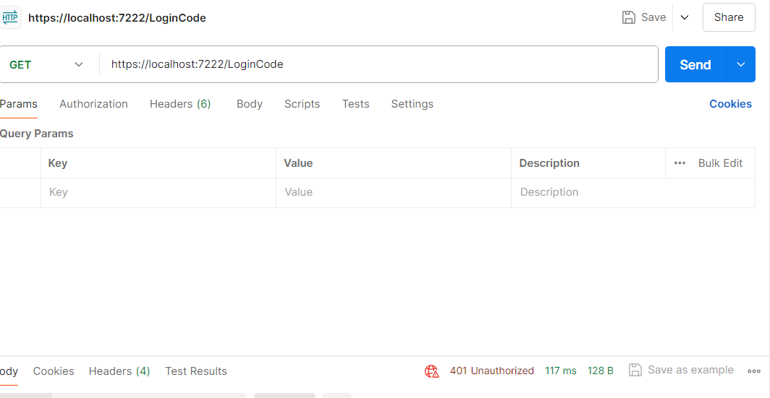
EXECUTION – UNAUTHORIZED USERS
An error message is gotten once an unauthorized (unregistered) user demands access to the data.
Users will not be able to access the login information needed to access computers at the café without first registering.
A ‘401 Unauthorized’ status message is returned by the server.

Slide 15
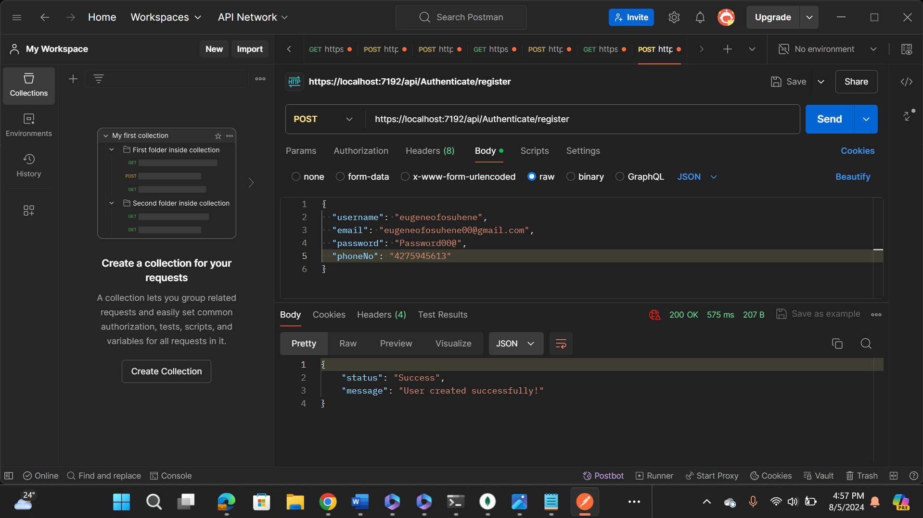
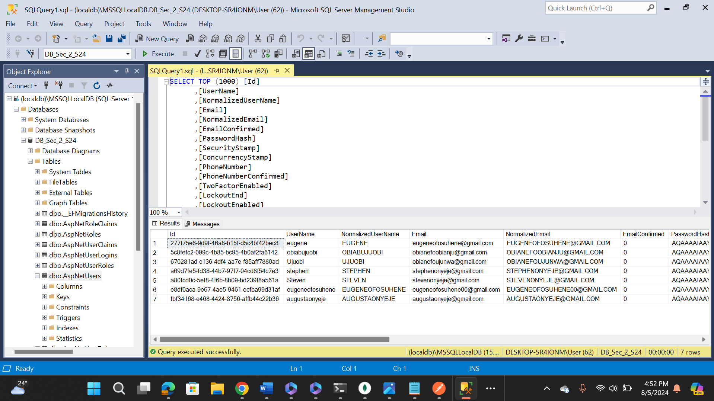
EXECUTION - REGISTRATION
A user first has to register to access the data (login Pins for the computers).
The POST Method allows registration and appending of new data into the database.
Once successful, server returns a ‘200 OK’ status message.
New user records are then appended to the database.

Slide 16
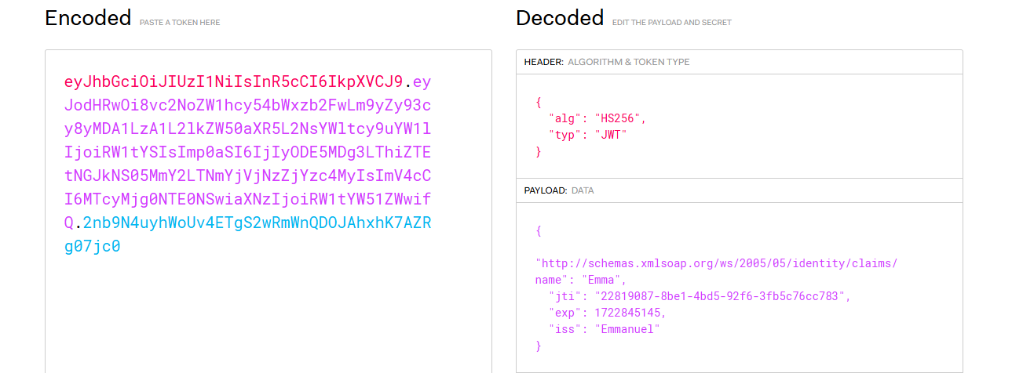
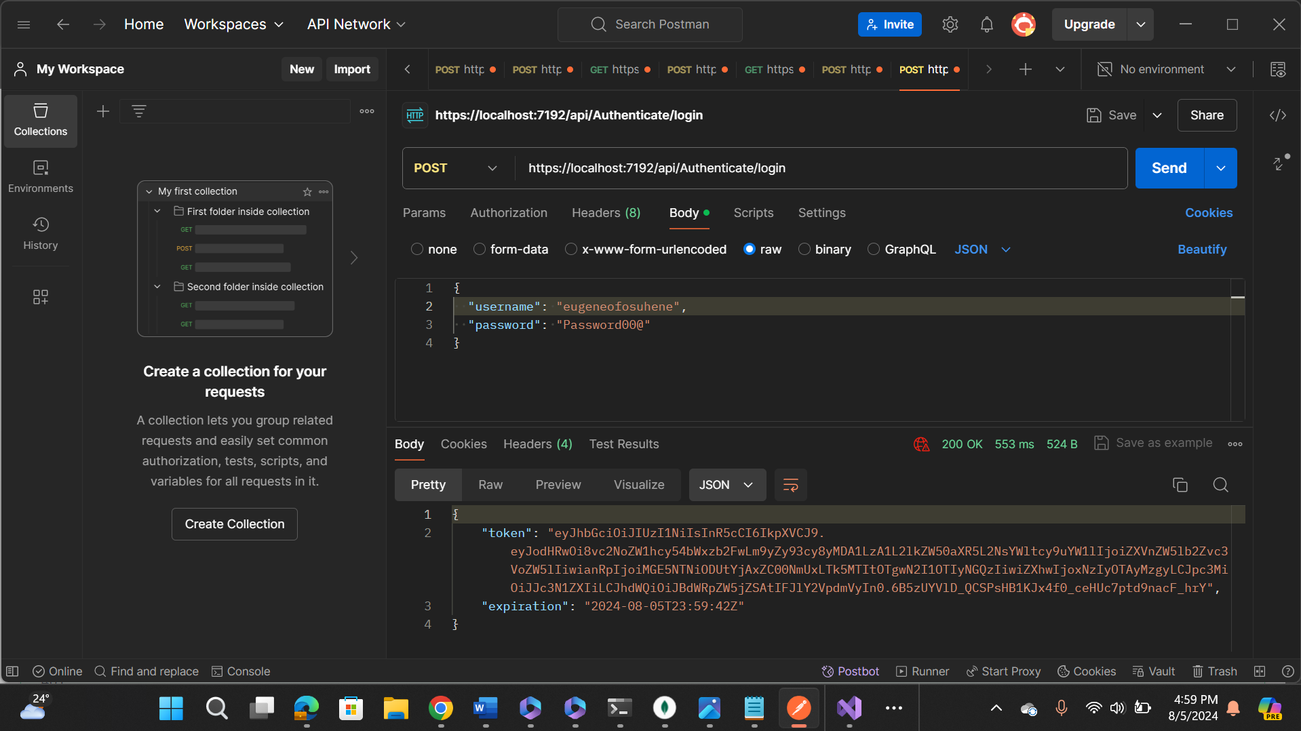
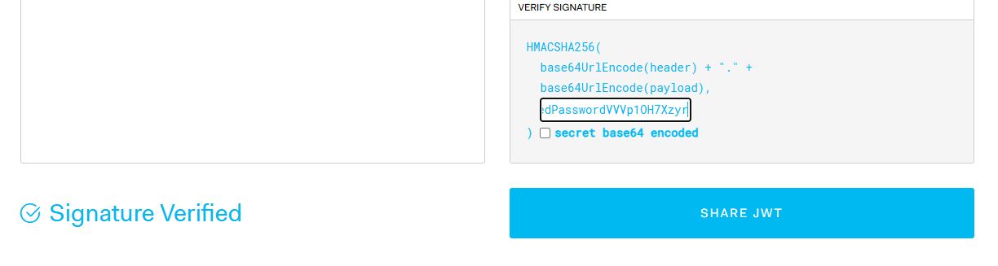
Execution - LOGINS
After registering, Users have to login with usernames and passwords. (Again POST Method)
A JWT Token is then generated and verified.
The JWT Token is made up of the Header, Payload and Signature.
The Token will allow authorisation to be passed to the user.

Slide 17
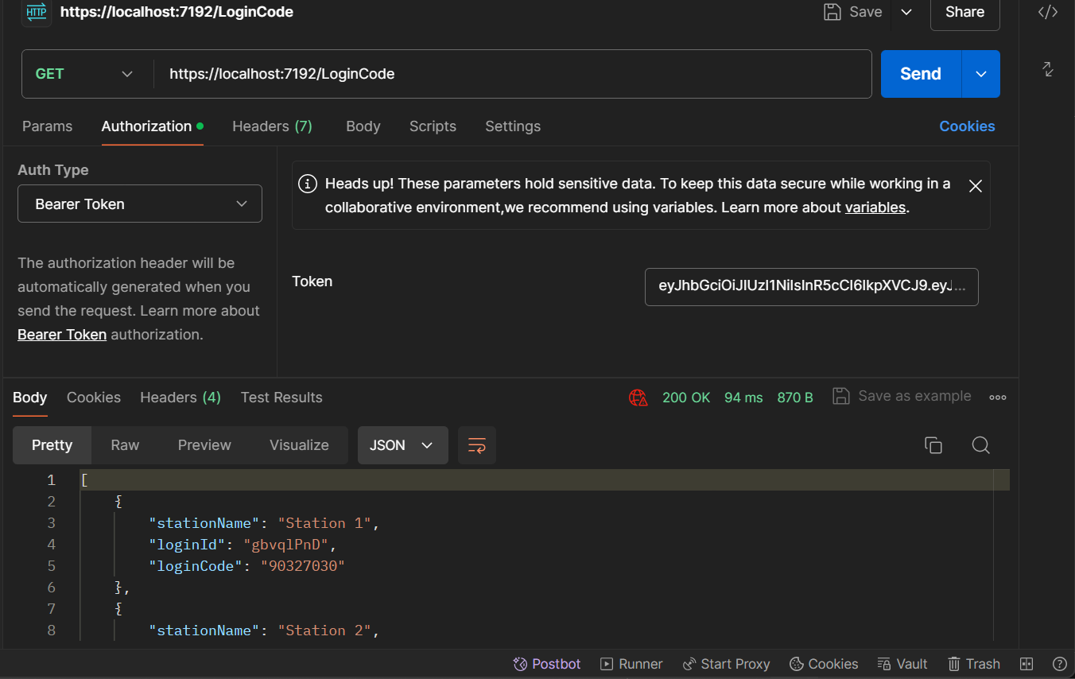
EXECUTION - AUTHORIZATION AND ACCESS
To give users access, the JWT token is passed through Authorization.
The initial ‘401 Authorize’ status message changes to ‘200 OK,’ after Authorization.
The user can now access the data and login to the computers of the corresponding stations.

Slide 18
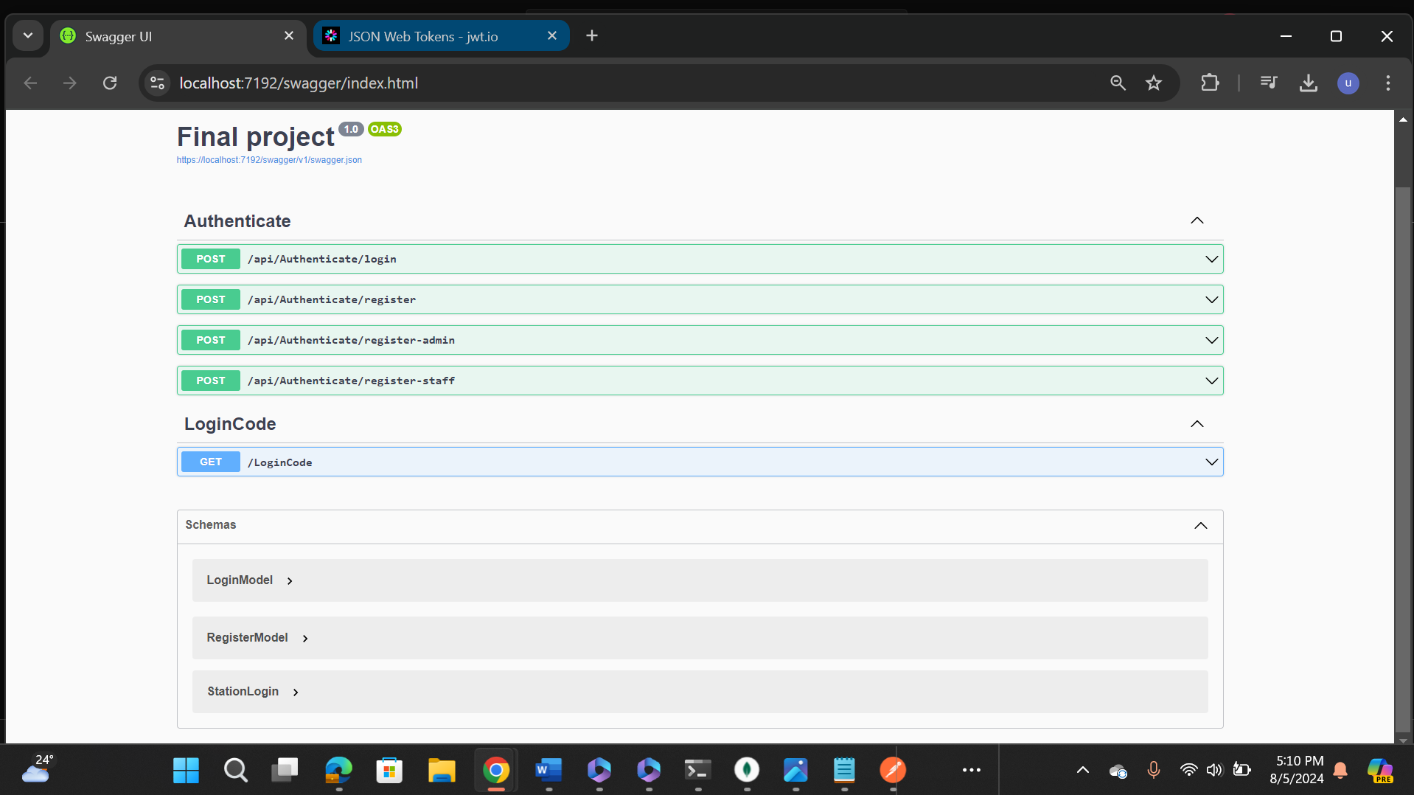
LIVE DEMO

Slide 19
THANK YOU

